Slide 1
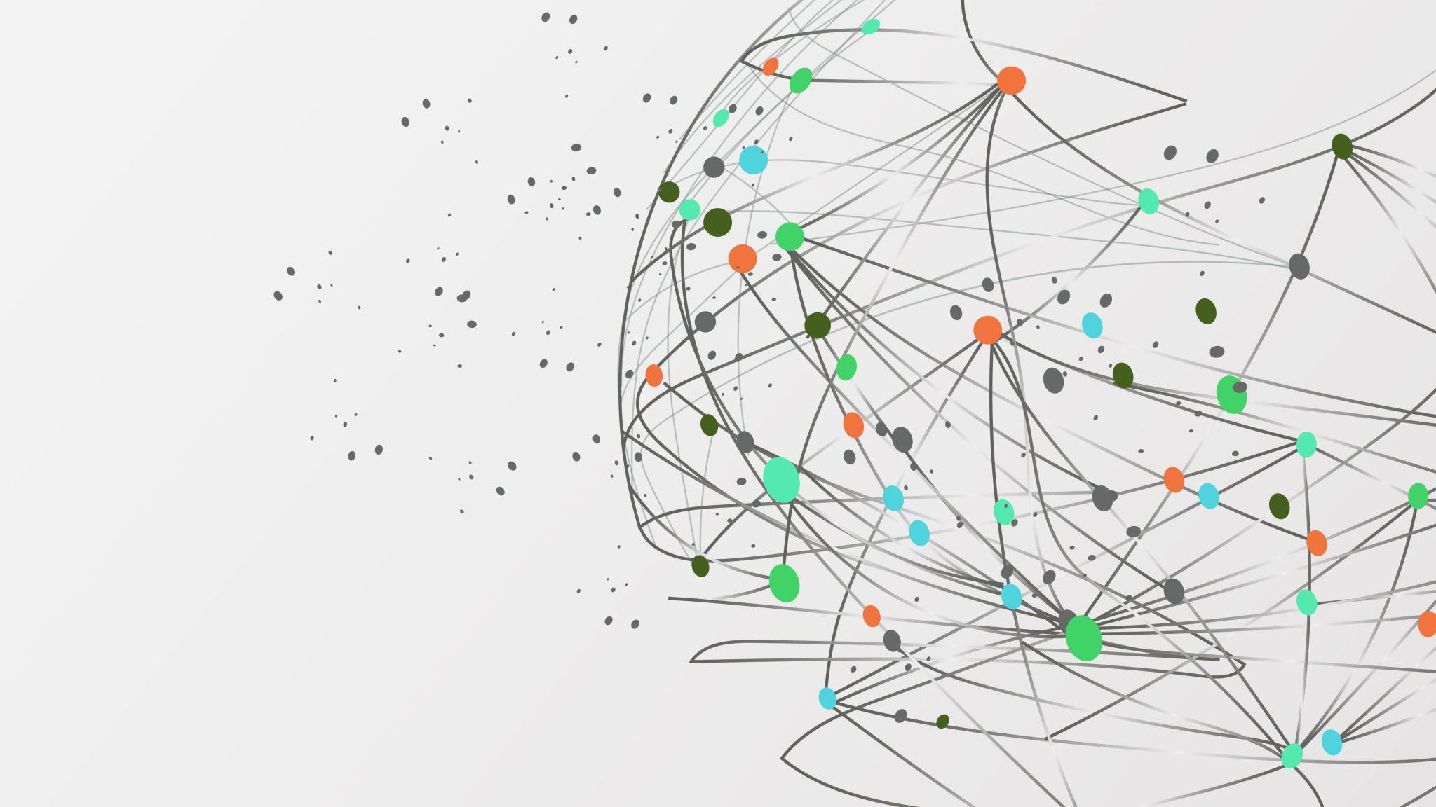
Autoencoder
Leen Alresheq

Slide 2
What is an Autoencoder?
An autoencoder is a neural network that learns how to compress data and then reconstruct it.
How it works
Encoder → takes the input and compresses it into a smaller representation
Decoder → uses that compressed representation to rebuild the original input
Why it matters
Learns important features of the data automatically

Slide 3
Problem Being Solved
The goal of this project is to build an autoencoder that learns how to:
Compress an image into a low-dimensional representation (embedding)
Reconstruct the original image from that compressed form as accurately as possible
A real-world application of this idea could be reducing the size of images or videos to save storage.

Slide 4
Data Preparation
Dataset used: MNIST handwritten digits

Slide 5
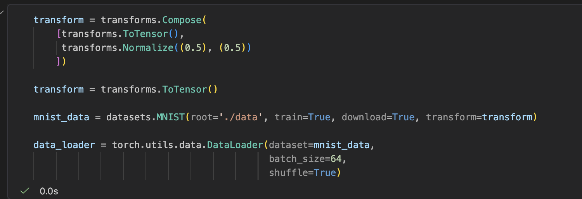
This code converts the images into tensors, groups them into batches of 64, and shuffles them so the autoencoder can train efficiently.

Slide 6
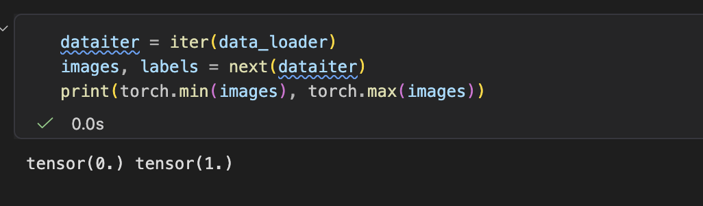
This code checks the pixel value range of the input images so the decoder uses the correct output function.

Slide 7
Method Used to Solve It
Two different autoencoders were implemented:
Linear Autoencoder
Convolutional Autoencoder

Slide 8
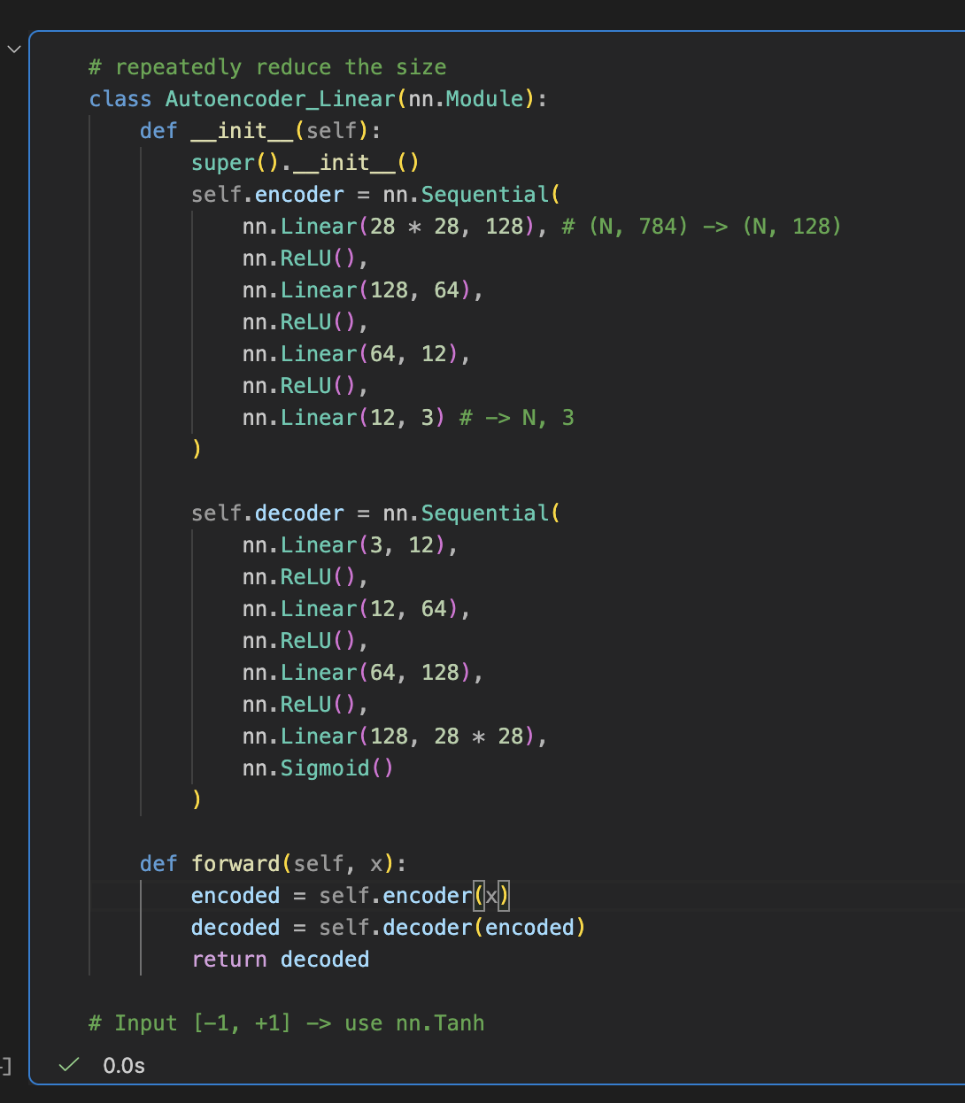
This linear autoencoder repeatedly reduces the input size into a small embedding, then expands it to reconstruct the original image.

Slide 9
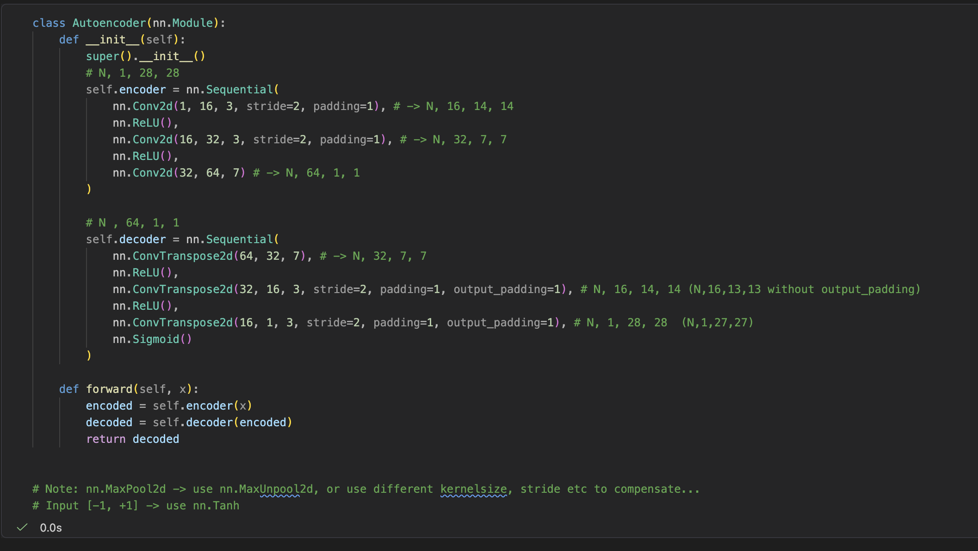
This convolutional autoencoder compresses images using convolutional layers that reduce spatial size, then reconstructs them using transpose convolutions to restore the original image.

Slide 10
Training Setup
Loss function: Mean Squared Error (MSE)
Optimizer: Adam

Slide 11
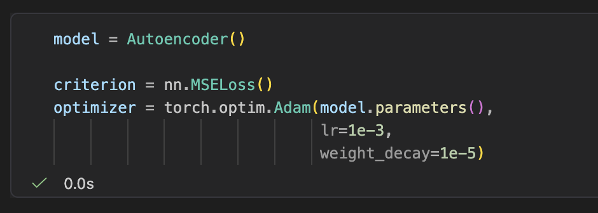
This code initializes the autoencoder, defines MSE loss to measure reconstruction error, and uses the Adam optimizer to update the model during training.

Slide 12
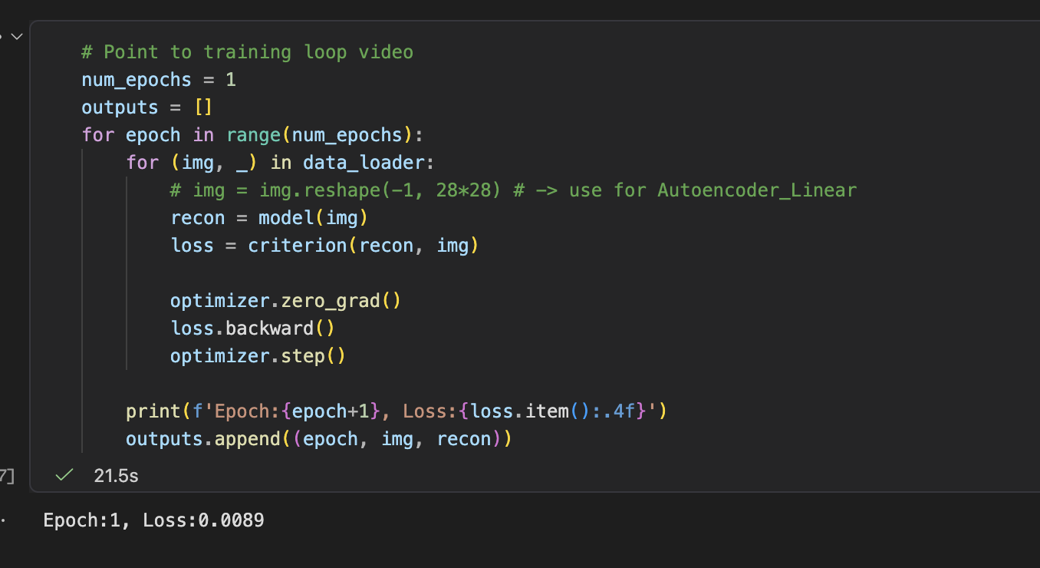
This training loop feeds batches of images into the autoencoder, computes reconstruction loss, and updates the model weights to improve image reconstruction over time.

Slide 13
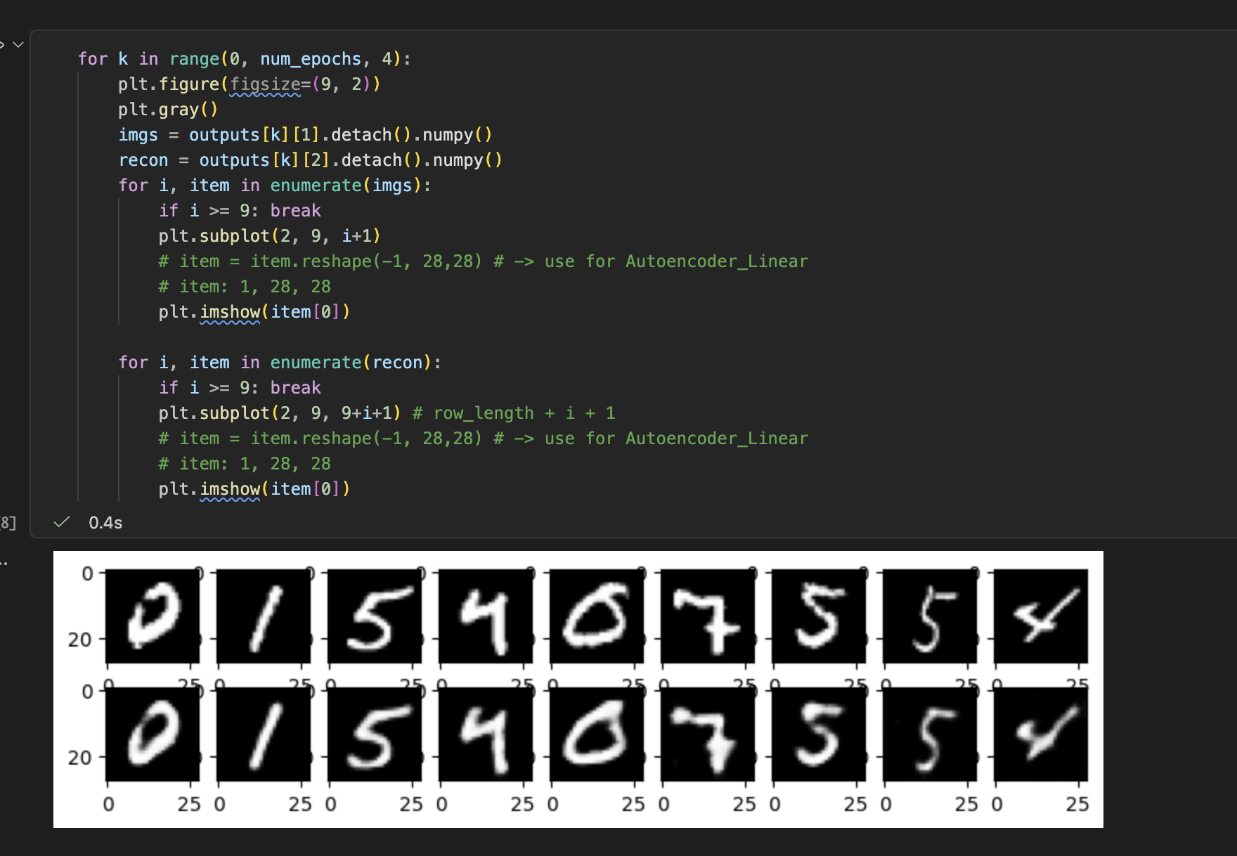
This code compares original images and reconstructed outputs across different epochs to show how the autoencoder improves its reconstruction quality over time.
Results

